Slide 1
Searching Technique with Algorithm

Slide 2
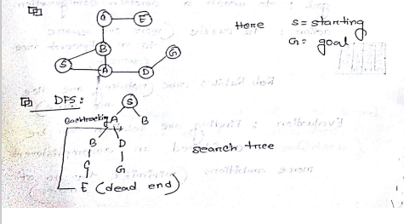
Searching Technique with Algorithm(cont.)

Slide 3
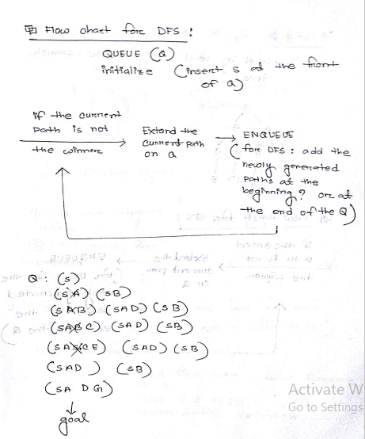
Searching Technique with Algorithm(cont.)

Slide 4
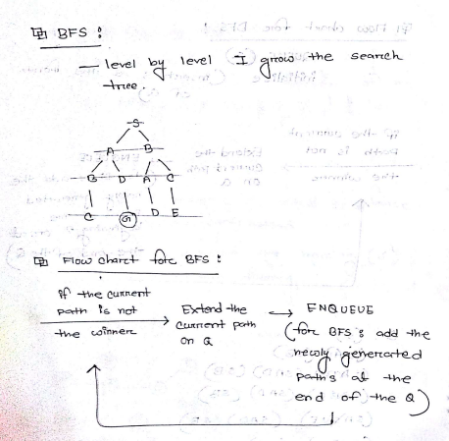
Searching Technique with Algorithm(cont.)

Slide 5
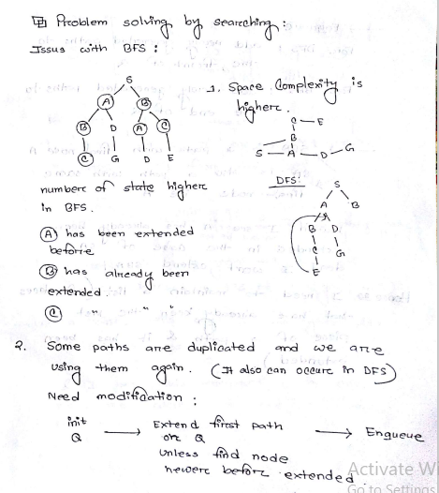
Searching Technique with Algorithm(cont.)

Slide 6
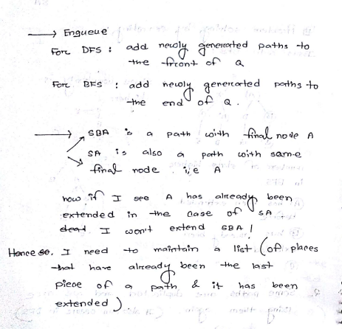
Searching Technique with Algorithm(cont.)

Slide 7
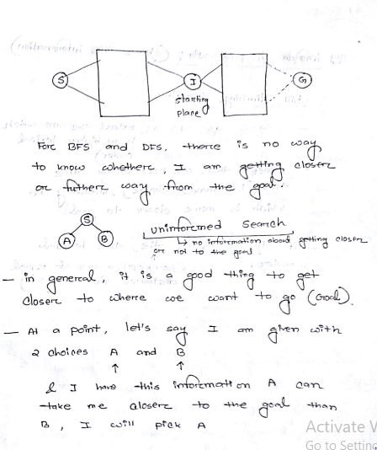
Searching Technique with Algorithm(cont.)

Slide 8
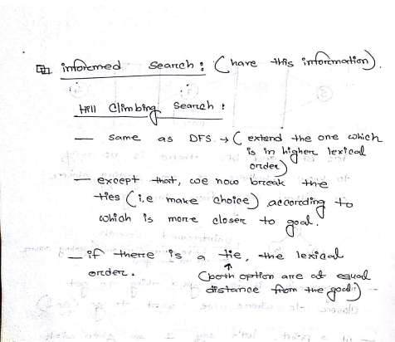
Searching Technique with Algorithm(cont.)

